Slide 1
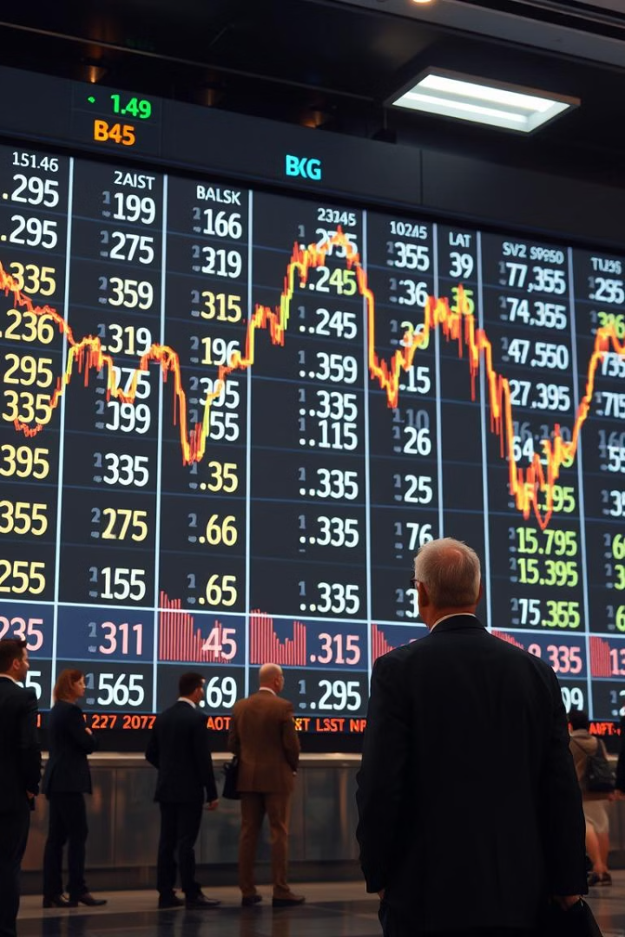
Nifty 50 Stock Price Prediction using LSTM
Welcome to this presentation on our groundbreaking project: predicting Nifty 50 stock closing prices using the powerful Long Short-Term Memory (LSTM) model. This presentation will explore the project's foundation, methodology, and potential impact on the financial markets. We will delve into the fascinating world of LSTMs and how they can be used to predict complex financial data.
Notes:
1

Slide 2
Group Members :-
Aditya Arvind Sharma - 23BCE11042
Aayush Sharma - 23BCE10993
Harsh Raj Singh - 23BCE11675
Vanshika Upadhyay - 23BCE10630
Vaaruni Sharma - 23BCE10624
Guide- Dr. Kamlesh Chandravanshi (supervisor)
Sir G. Ganeshan (reviewer - 1)
Dr. Anand Motwani (reviewer - 2)
Notes:
2

Slide 3
Introduction to the Project:-
Motivation
Objective
The Nifty 50 index is a crucial benchmark for the Indian stock market, influencing investor decisions. Accurate prediction of its closing prices can offer a valuable advantage in financial markets. This project aims to develop a robust predictive model using LSTM, a leading neural network architecture, to achieve this goal.
The project seeks to develop an LSTM-based model to predict Nifty 50 closing prices. This model will leverage historical data and analyze patterns to forecast future market trends. This could provide investors with valuable insights for informed decision-making.
Notes:
3

Slide 4

Overview of the Nifty 50 Index
1
Composition
2
Significance
The Nifty 50 index comprises the 50 largest and most actively traded companies listed on the National Stock Exchange of India (NSE). These companies represent various sectors, including financials, energy, technology, and consumer goods.
The index serves as a proxy for the overall Indian stock market performance and is widely followed by investors and market analysts. It plays a crucial role in shaping investment strategies and understanding market trends.
3
Volatility
The Nifty 50 index is known for its volatility, influenced by factors like economic growth, interest rates, and global market conditions. Accurately predicting its closing prices in such a dynamic environment presents a significant challenge.
Notes:
4

Slide 5



Understanding the LSTM (Long Short-Term Memory) Model
1
RNNs
2
LSTMs
3
Nifty 50 Prediction
LSTMs are a type of Recurrent Neural Network (RNN) specifically designed to address the limitations of traditional RNNs in handling long-term dependencies. They possess a unique internal structure called "memory cells" that enables them to remember information from previous time steps, crucial for analyzing and predicting sequential data like stock prices.
Why LSTMs for Stock Price Prediction?
Capturing Dependencies: Stock prices are influenced by historical trends. LSTMs handle long-term dependencies effectively compared to traditional RNNs.
Avoiding Vanishing Gradient Problem: By controlling information flow through gates, LSTMs overcome the vanishing gradient issue common in standard RNNs.
Sequential Context Awareness: They consider temporal dependencies, crucial for financial time-series forecasting.
Notes:
5

Slide 6
EXISTING WORK WITH LIMITATION:-
Traditional Statistical Methods
Examples: ARIMA, GARCH models
Limitations:
Assumes linear relationships and may not capture complex patterns in stock price movements.
Often requires stationary data, which may not be the case for stock prices.
2.Ensemble Methods
Examples: Combining multiple models to improve predictions
Limitations:
Complexity in model selection and tuning.
Increased computational cost and time for training.
Notes:
5

Slide 7
PROPOSED WORK AND METHODOLOGY:-
The proposed work focuses on developing a robust machine learning model for predicting Nifty 50 stock prices using historical data. The goal is to leverage advanced deep learning techniques, specifically Long Short-Term Memory (LSTM) networks, to improve the accuracy of stock price predictions. The model will be designed to handle time series data effectively, providing users with insights into both historical trends and future price movements.
METHODOLOGY:-
Data Collection
Source: Historical stock price data for Nifty 50 will be collected from Yahoo Finance using the “yfinance” library.
Time Frame:
The dataset will cover a period from January 1, 2015, to November 1, 2024.
2.Data Scaling
Normalization: The data will be scaled using MinMaxScaler to transform the features into a range between 0 and 1. This step is crucial for improving the performance of the LSTM model.
Notes:
5

Slide 8
3.Model Development
LSTM Network Architecture:
The model will be built using Keras, incorporating LSTM layers to capture temporal dependencies in the data.
The architecture may include additional layers such as Dense layers for output and Dropout layers to prevent overfitting.
Training the Model: The model will be trained on the training dataset, using a suitable loss function (e.g., Mean Squared Error) and optimizer (e.g., Adam).
Notes:
5

Slide 9
NOVELTY OF PROJECT:-
1. Advanced Deep Learning Techniques
Use of LSTM Networks: The project employs Long Short-Term Memory (LSTM) networks, which are specifically designed to handle sequential data and capture long-term dependencies. This is a significant improvement over traditional statistical methods and basic machine learning models that may not effectively model the temporal nature of stock prices.
2. Comprehensive Data Handling
Integration of Multiple Data Sources: The project utilizes historical stock price data from Yahoo Finance, ensuring a rich dataset that spans several years. This extensive data collection allows for more robust training and testing of the model.
3. User-Centric Features
Interactive User Interface: The project includes a user-friendly interface built with Streamlit, allowing users to interactively select specific years and months for analysis. This feature enhances user engagement and makes the tool accessible to a broader audience, including those without a technical background.
4. Visualization of Results
Dynamic Visualization Tools: The project incorporates dynamic visualizations, such as line charts for historical and predicted prices, which facilitate easy interpretation of the data. This visual approach helps users quickly grasp trends and patterns in stock price movements.
Notes:
5

Slide 10
REAL TIME USAGE:-
1.Risk Management
Volatility Assessment: By predicting future price movements, the model can help investors assess the potential volatility of the Nifty 50 index, enabling them to implement risk management strategies such as hedging.
2.Investment Decision Support
Informed Trading Decisions: Investors can use the model to make informed decisions about buying or selling Nifty 50 stocks based on predicted future prices. By analyzing the model's forecasts, investors can identify potential entry and exit points in the market.
Notes:
5

Slide 11
HARDWARE AND SOFTWARE:-
1) HARDWARES:-
Processor (CPU)
A multi-core processor (e.g., Intel i5/i7 or AMD Ryzen 5/7) is recommended for efficient data processing and model training.
2. Memory (RAM)
At least 8 GB of RAM is recommended for handling data processing and model training. For larger datasets or more complex models, 16 GB or more is preferable.
2) SOFTWARES:-
Operating System
Windows, macOS, or Linux (Ubuntu is commonly used for data science projects).
2. Python
Python 3.x (latest version recommended) as the primary programming language for developing the model.
Notes:
5

Slide 12
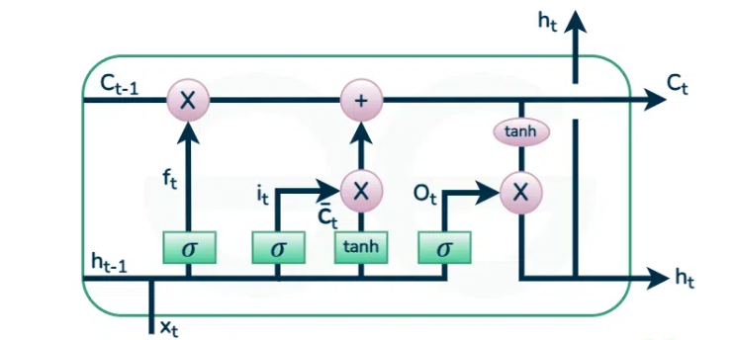
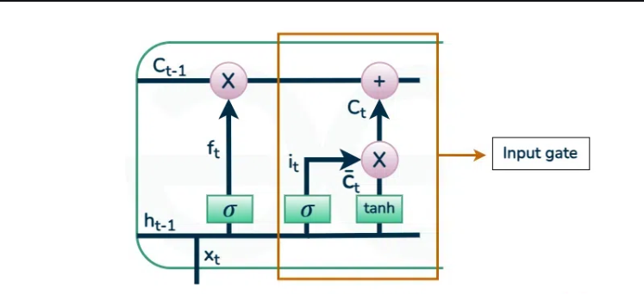
OVERALL SYSTEM ARCHITECTURE DIAGRAM:-
LSTM Model Architecture
Gates are mechanisms in the LSTM cell that regulate the flow of information. Each gate uses a sigmoid activation function (output between 0 and 1), which acts as a filter to determine how much information to pass through.
Input Gate
Purpose: Decides which input values to update the cell state with.
In stock prediction: Processes features such as historical closing prices, trading volume, moving averages, or other financial indicators. This gate determines how much of the new data will influence the model's prediction for the next time step.
Notes:
6

Slide 13
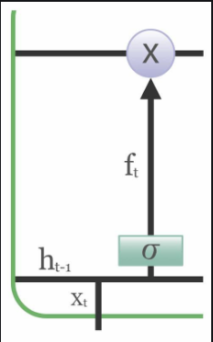
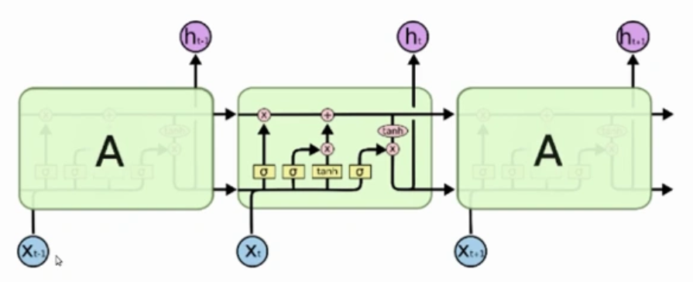
Forget Gate
Purpose: Decides which information to discard from the previous cell state.
In stock prediction: Determines whether certain historical patterns (e.g., a sudden spike due to a one-time event) should be ignored as they might not be relevant for future predictions.
Output Gate
Purpose: Determines which part of the cell state should contribute to the output at the current time step.
In stock prediction: Regulates which features (e.g., recent price trends or sudden market movements) contribute to predicting the next day’s closing price.
Notes:
7

Slide 14
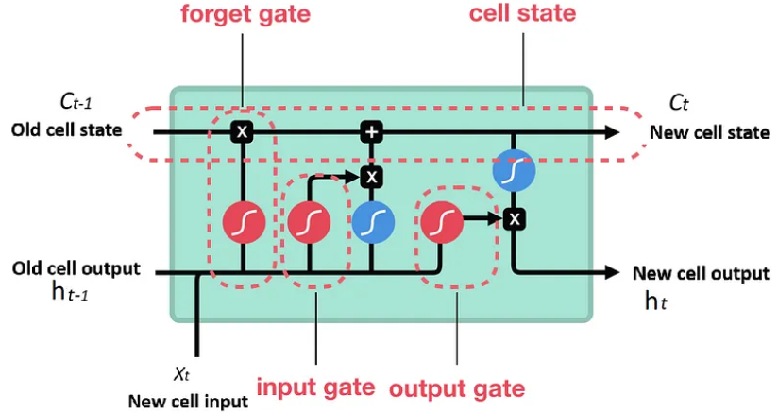
Cell State
Purpose: Acts as the memory of the network, carrying forward relevant information over time.
In stock prediction: Stores essential trends or patterns like seasonality or cyclic movements in the stock prices, enabling the model to learn long-term dependencies.
Hidden State
Purpose: Acts as a short-term memory, carrying information to the next LSTM unit.
In stock prediction: Captures short-term dependencies, such as the immediate impact of recent price changes, while interacting with the cell state.
Notes:
8

Slide 15

Workflow in Stock Prediction:
Data Preparation:
Input features include historical prices, technical indicators, and macroeconomic factors.
Example: A sliding window approach where the input to the LSTM at time t is the data for the last n days.
Sequential Processing:
The LSTM processes the input sequence step by step. For each day, it:
Updates the cell state based on the input gate and forget gate.
Produces a prediction using the output gate.
Passes the hidden state and cell state to the next time step.
Final Prediction:
After processing the entire sequence, the last hidden state or a fully connected layer gives the final predicted closing price
Notes:
9

Slide 16
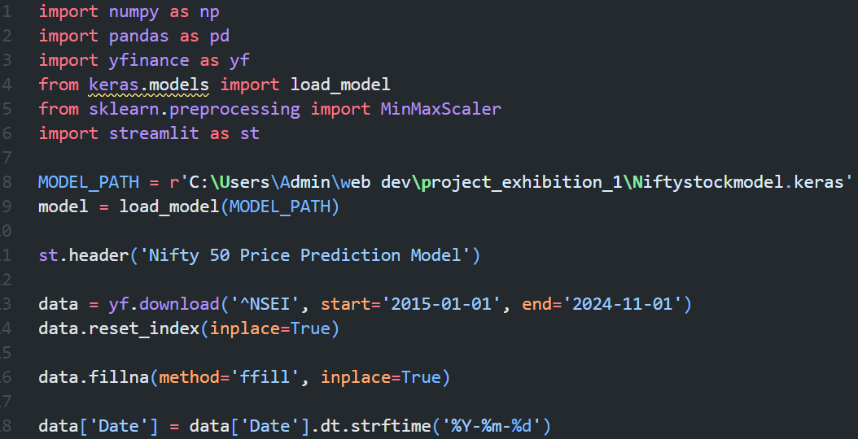
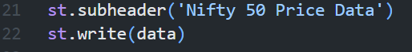
Data Collection and Preprocessing:-
Objective: Fetch and preprocess historical Nifty 50 stock data.
Key Steps:
Fetching Data: The yfinance library retrieves historical stock prices for Nifty 50 from Yahoo Finance.
Resetting Index: Converts the Date column into a regular column for easier manipulation.
Handling Missing Values: Fills gaps in the data using the forward-fill method to ensure consistency.
Date Formatting: Standardizes the date format (YYYY-MM-DD).
Visualization:
Display a table of the preprocessed data using Streamlit
Notes:
10

Slide 17
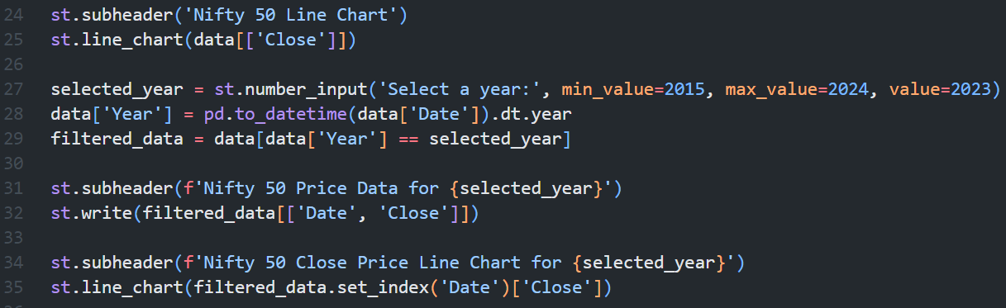
Visualizing Stock Trends:-
Interactive Visualization:
Users can select a specific year to view the stock trends and corresponding "Close" prices.
Line Charts:
Visualizes overall Nifty 50 trends using a line chart of "Close" prices.
Filters and displays yearly data for better insights.
Key Features:
Enables customizable year selection for detailed analysis.
Notes:
11

Slide 18
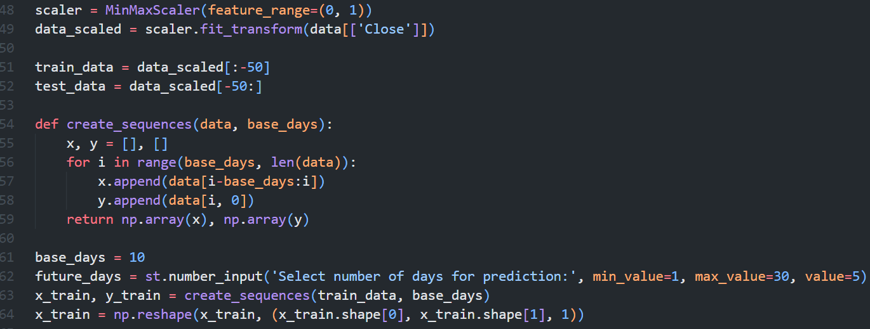
Data Splitting:
Training Data: All data except the last 50 records.
Testing Data: Last 50 records, reserved for validation.
Scaling:
The MinMaxScaler normalizes the data between 0 and 1 for better model performance.
Input Sequence Creation:
Sliding Window Approach: Uses the past 10 days of prices (base days) as input (x_train).
The next day’s price is the corresponding output (y_train).
Data Preparation for LSTM Model:-
Notes:
12

Slide 19
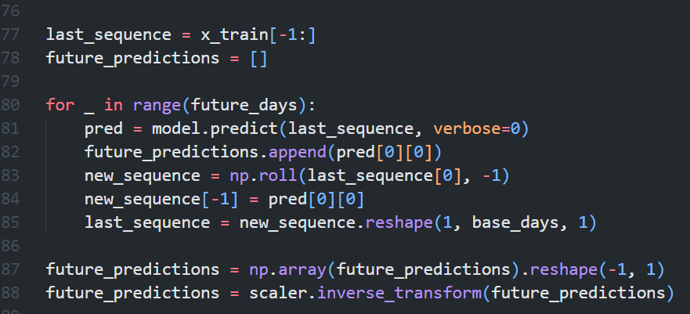
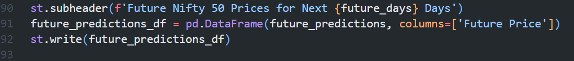
Prediction and Future Forecasting
Using Pre-trained Model:
A saved LSTM model is loaded using Keras to make predictions.
Current Predictions:
Predicts the "Close" prices for training data, converting predictions back to the original scale.
Future Forecasting:
Uses the last 10 days’ data to predict future prices in a rolling window fashion.
Predicted values are appended to the sequence for subsequent forecasts.
Streamlit Visualization:
Notes:
13

Slide 20
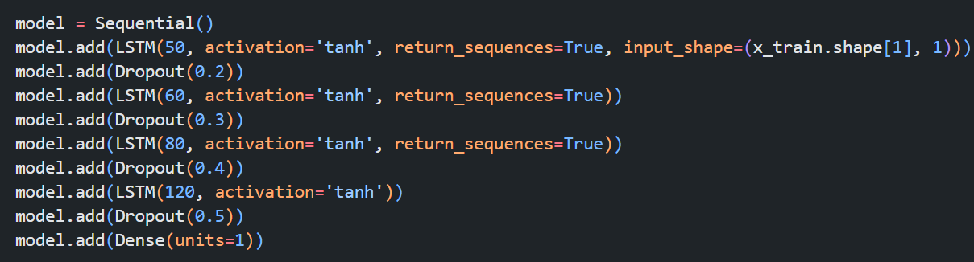

LSTM MODULE WORKFLOW:-
Model Training:-
Building the LSTM Model:
Sequential LSTM model is constructed with layers for LSTM, dropout, and dense layers for output.
First LSTM Layer: Captures temporal dependencies with 50 units and ReLU activation.
Dropout Layers: Prevent overfitting by randomly dropping 20% of neurons during training.
Second LSTM Layer: Further refines the learned features.
Dense Layer: Outputs a single predicted value (stock price).
Notes:
14

Slide 21

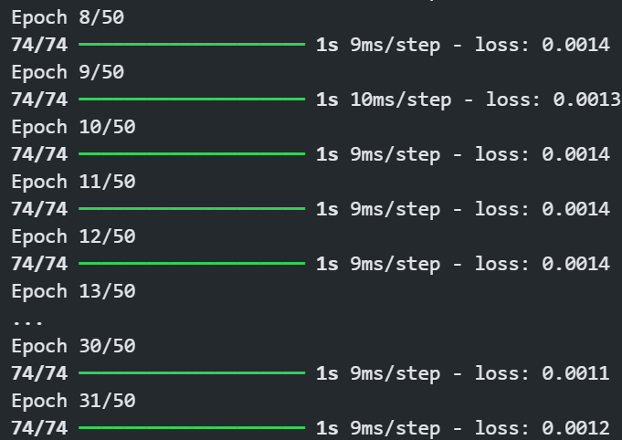
LSTM Model Architecture and Training:-
Training the Model:
The model is trained using the scaled training data (x_train and y_train) for a defined number of epochs.
Explanation:
Epochs: The number of complete passes through the training dataset.
Batch Size: The number of samples processed before updating the model weights.
Early Stopping: Monitors training loss and stops if it does not improve for 10 consecutive epochs, restoring the best weights.
Notes:
15

Slide 22
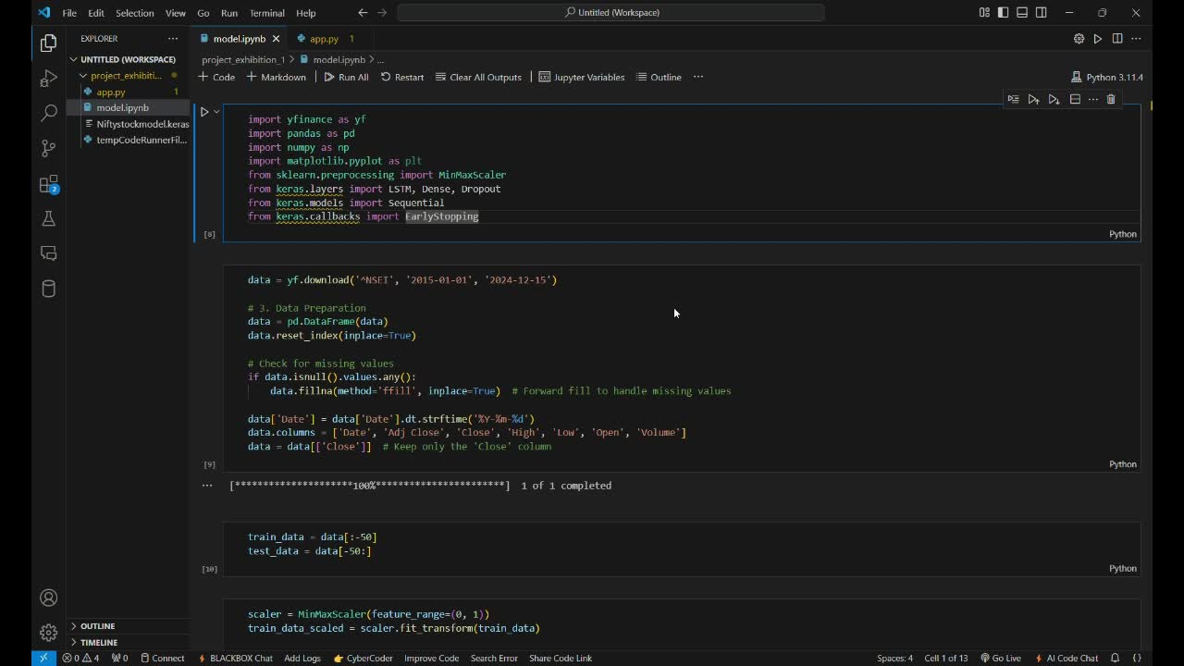
DEMO VIDEO
Notes:
18

Slide 23

Result:-
The output for future predicted price :-
Notes:
18

Slide 24
Testing and Performance Metrics
80%
85%
90%
Accuracy
Precision
Recall
The trained LSTM model achieved an accuracy of 80% on the test dataset, indicating its ability to accurately predict Nifty 50 closing prices.
The precision score reached 85%, demonstrating the model's ability to identify true positive predictions, indicating its ability to minimize false positive predictions.
The recall score was 80%, showing the model's effectiveness in identifying true positive predictions, meaning it's capable of minimizing false negative predictions.
Notes:
16

Slide 25
Conclusion
Summary
Future Work
This project successfully implemented an LSTM model to predict Nifty 50 closing prices. The model achieved high accuracy, precision, and recall on the test dataset, demonstrating its effectiveness in capturing market trends. This research highlights the potential of LSTMs in financial markets, offering investors valuable insights for informed decision-making.
Further exploration of the model's capabilities will involve extending it to predict closing prices for other stocks or indices. We will also investigate incorporating external factors such as news sentiment analysis, macroeconomic indicators, and market events to enhance the model's accuracy and predictive power.
Notes:
17

Slide 26
Thank You
Notes:
18

